Slide 2
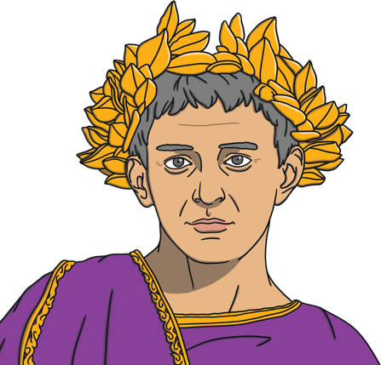
Valentine was a Roman priest who lived during the third century. At the time, Rome was ruled by an emperor called Claudius.
Claudius was sometimes known as Claudius the Cruel. He was involved in many wars and battles.

Slide 3
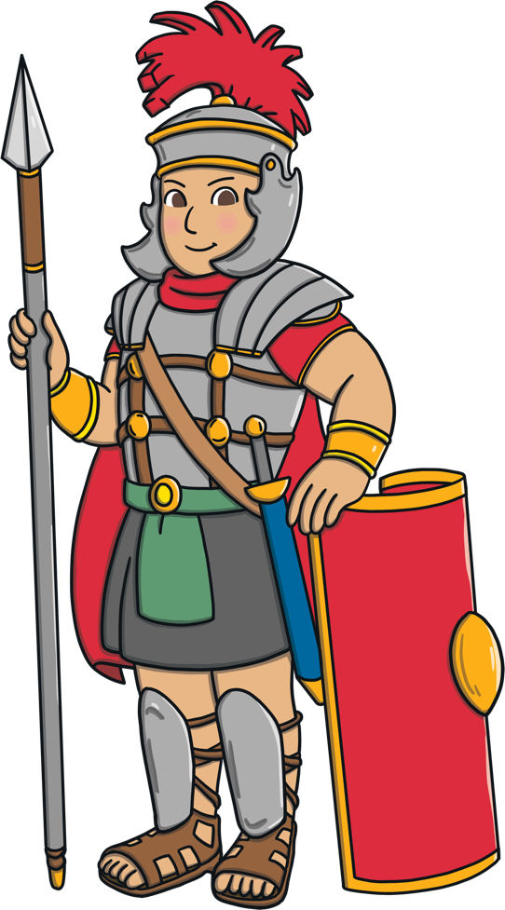
Claudius needed a strong army to fight his many wars. Many men did not want to fight as that would mean they would have to leave their wives and children.

Slide 4
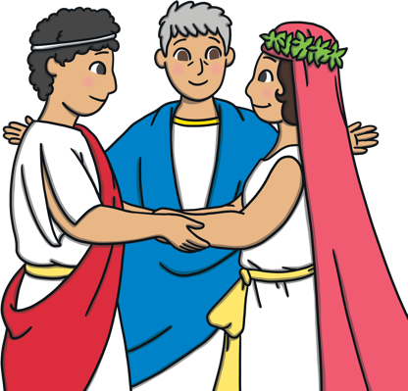
Claudius came up with a plan. He forbade all men from marrying. This meant that they would have no excuse to join the army and fight in his wars.
Valentine believed that people should be able to get married if they wanted to. As he was a priest, he began to help people to get married in secret.

Slide 5
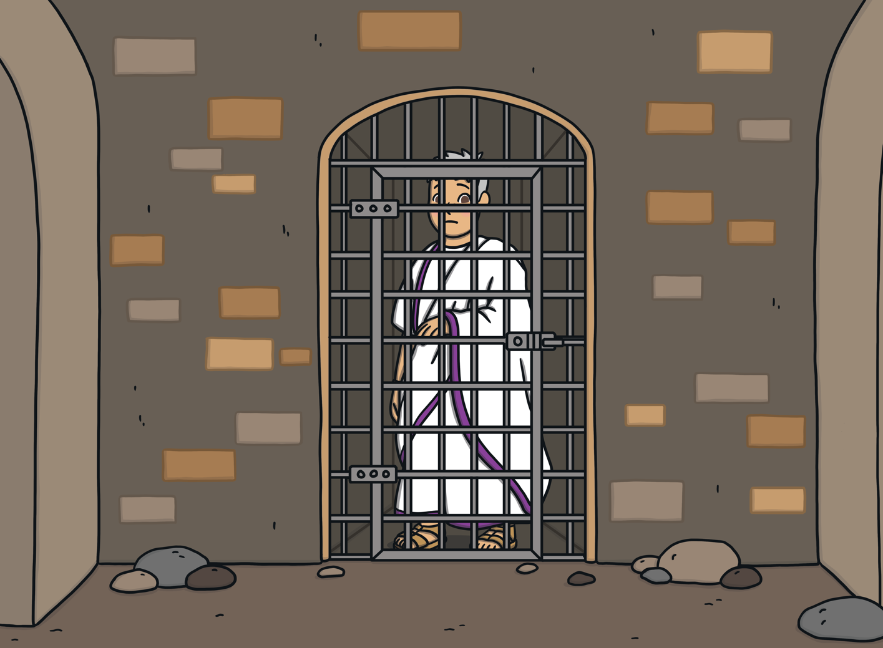
But Claudius soon found out that Valentine was marrying people in secret. He was very angry and ordered that Valentine be arrested and imprisoned.

Slide 6
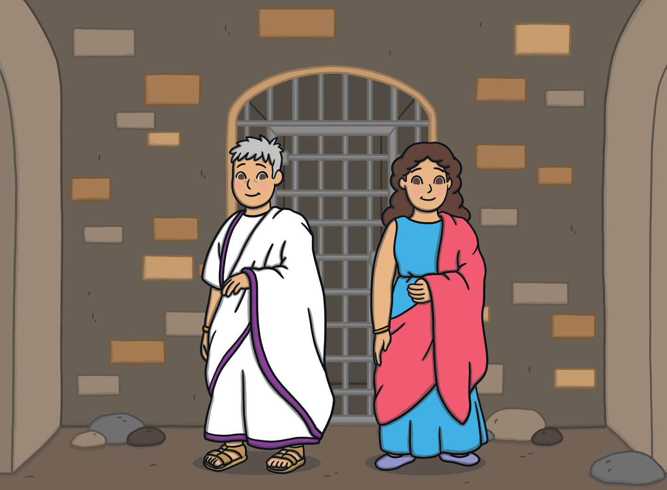
While in jail, Valentine became a teacher to his jailer’s blind daughter, Julia.

Slide 7
It is believed by many that Valentine performed a miracle when he asked God to cure Julia's blindness. After she was cured, Julia's father converted to Christianity.

Slide 8
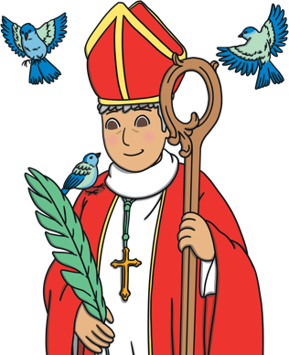
On the day that Valentine died, he wrote Julia a goodbye letter and signed it from ‘your Valentine’. Julia was able to read the note because God had cured her blindness. He died on the 14th February.
After he died, Valentine was made a saint by the Catholic church. He is known as a martyr. This is somebody who is killed because of their beliefs.

Slide 9
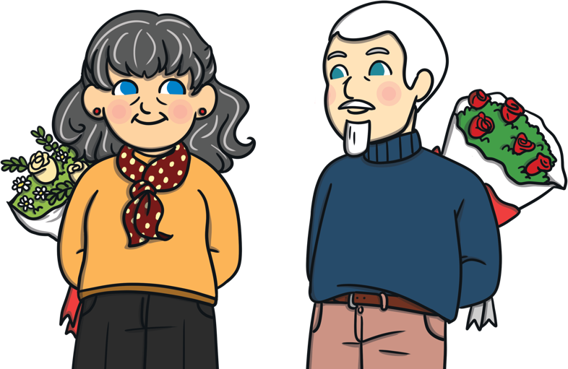
Today, we celebrate St. Valentine's Day by sending notes, giving gifts and being kind to people we care about. How will you celebrate it?

